Slide 1

Subject Name Software Engineering
Requirement
Documentation

Slide 2
Requirement Documentation
Important activity after requirement gathering.
It is also known as Software Requirement Specification (SRS).
It serves number of purposes.
Increase customer satisfaction level.

Slide 3
Nature of SRS
Functionality
External Interfaces
Performance
Attributes
Design constraints imposed on an implementation

Slide 4
Characteristics of a good SRS
The SRS should be:
Correct
Unambiguous
Complete
Consistent

Slide 5
Characteristics of a good SRS
Ranked for importance and/or stability
Verifiable
Modifiable
Traceable

Slide 6
Organization of SRS
IEEE has published guidelines & standards to organize an SRS document.
Different projects may require their requirements to be organized differently.

Slide 7
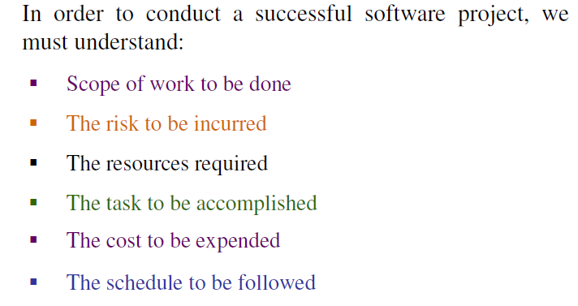
Cont……

Slide 8

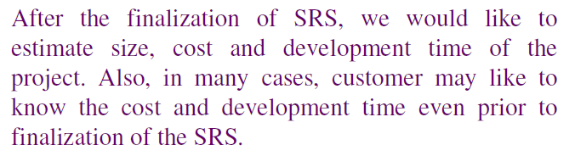

Slide 9

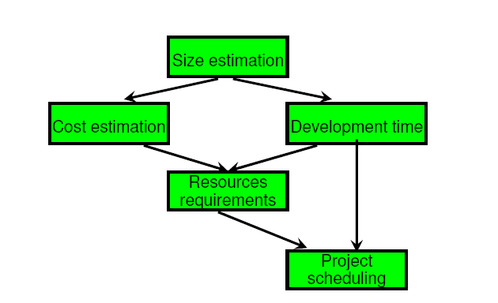

Cont….

Slide 10
Project size estimation techniques
Estimation of the size of software is an essential part of Software Project Management. It helps the project manager to further predict the effort and time which will be needed to build the project. Various measures are used in project size estimation. Some of these are:
Lines of Code
Number of entities in ER diagram
Total number of processes in detailed data flow diagram
Function points

Slide 11

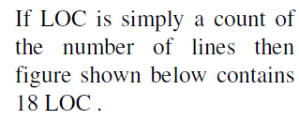
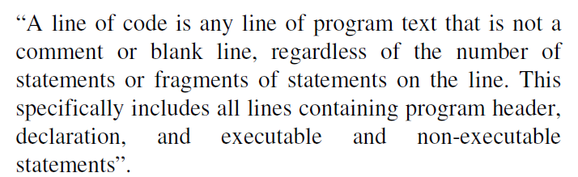

Slide 12
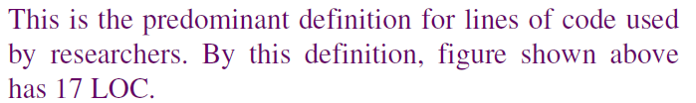
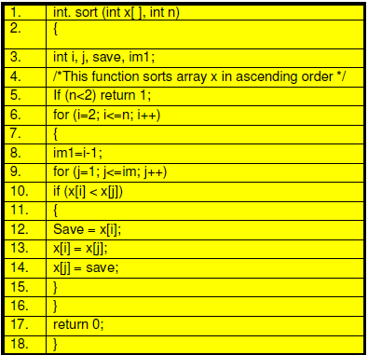

Slide 13
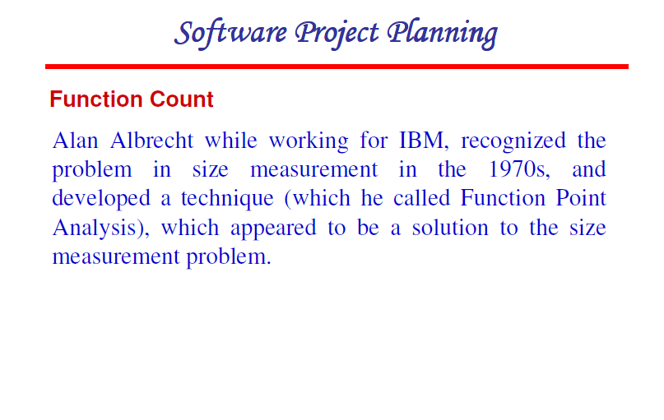

Slide 14
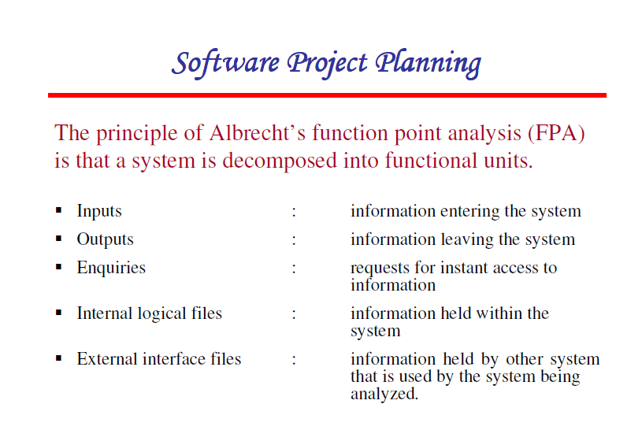

Slide 15
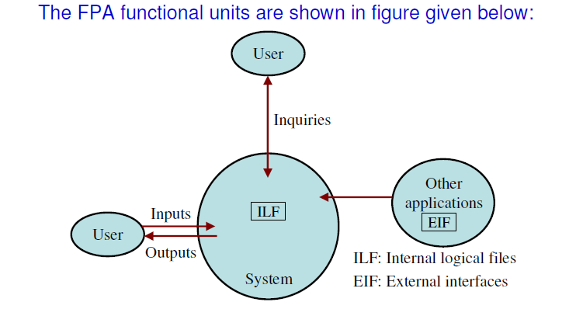

Slide 16
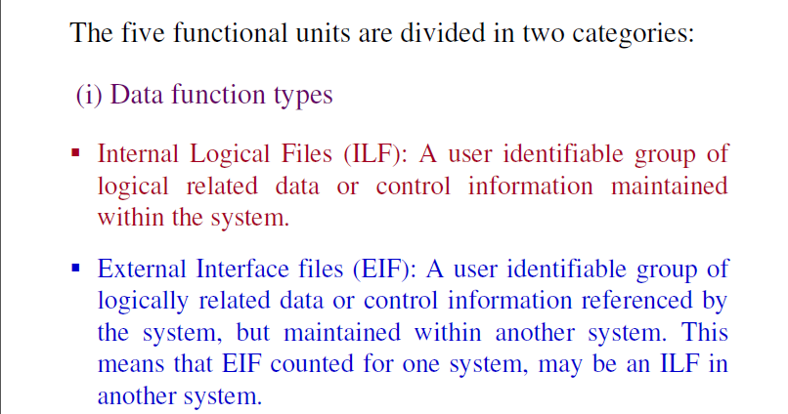

Slide 17
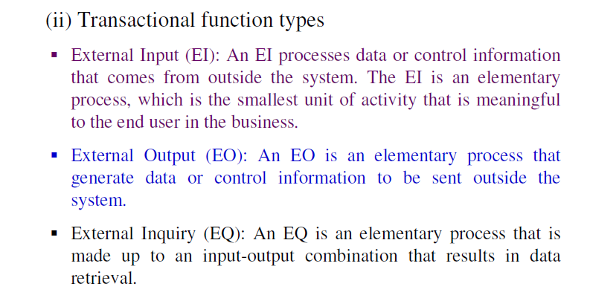

Slide 18
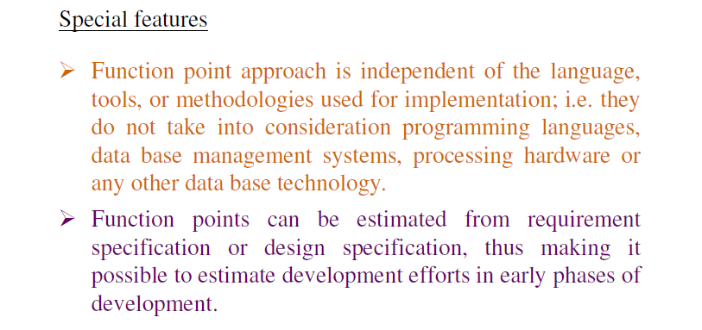

Slide 19
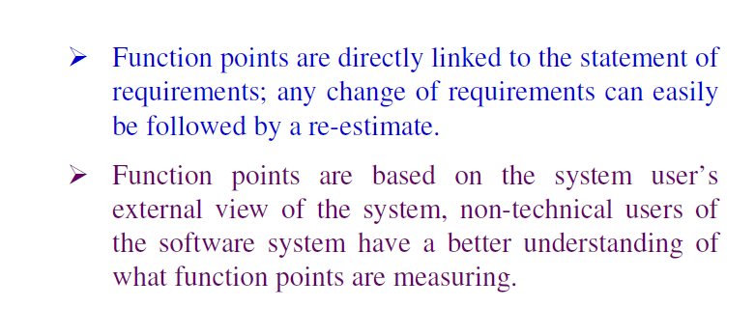

Slide 20
Calculation of Function Point
Calculate Function Point.FP = UFP * CAF
Where,UFP=unadjusted function point
Complexity Adjustment Factor (CAF).
CAF = 0.65 + ( 0.01 * F )
Where F=14*Scale, and scale can be calculated
0 - No Influence
1 - Incidental
2 - Moderate
3 - Average
4 - Significant
5 - Essential

Slide 21
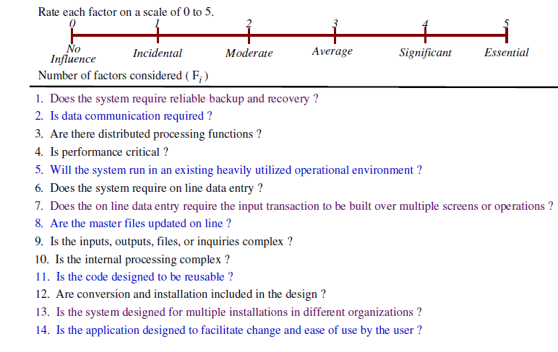

Slide 22
Calculate Unadjusted Function Point (UFP).
FUNCTION UNITS | LOW | AVG | HIGH
EI | 3 | 4 | 6
EO | 4 | 5 | 7
EQ | 3 | 4 | 6
ILF | 7 | 10 | 15
EIF | 5 | 7 | 10
Multiply each individual function point to corresponding values in TABLE.

Slide 23
Ex-1(Calculation of Functional Point)
Given the following values, compute function point when all complexity adjustment factor (CAF) and weighting factors are average.
User Input = 50 User Output = 40 User Inquiries = 35 User Files = 6 External Interface = 4

Slide 24
Step-1: As complexity adjustment factor is average (given in question), hence, scale = 3.
F = 14 * 3 = 42
Step-2:CAF = 0.65 + ( 0.01 * 42 ) = 1.07
Step-3: As weighting factors are also average (given in question) hence we will multiply each individual function point to corresponding values in TABLE.
UFP = (50*4) + (40*5) + (35*4) + (6*10) + (4*7) = 628
Step-4:Function Point = 628 * 1.07 = 671.96

Slide 25
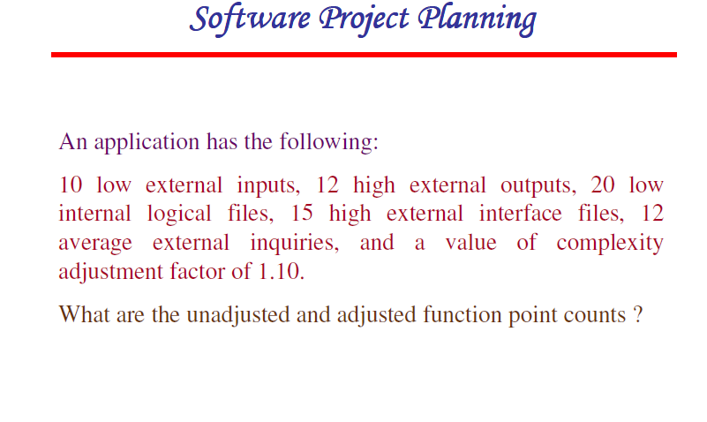

Slide 26
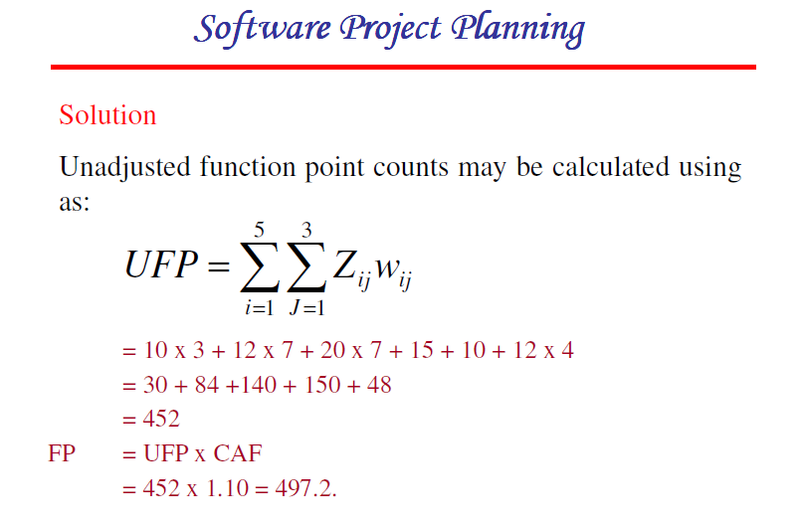

Slide 27
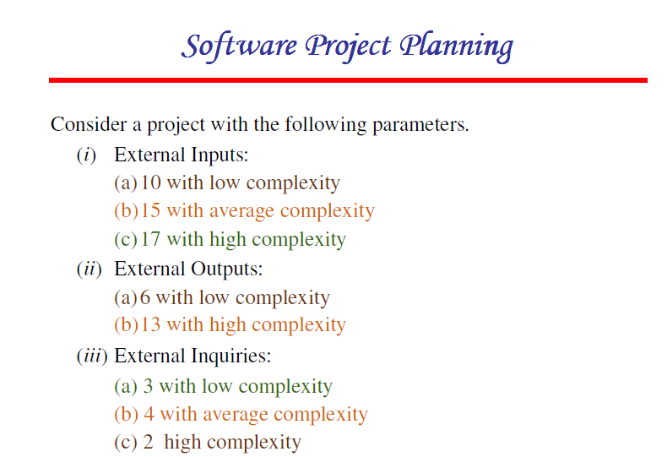

Slide 28
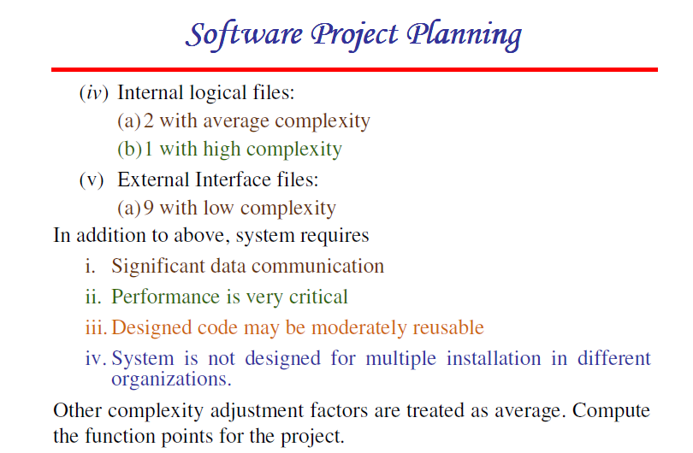

Slide 29
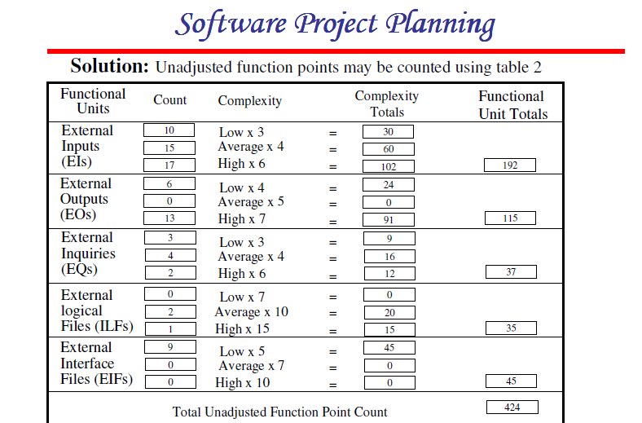

Slide 30
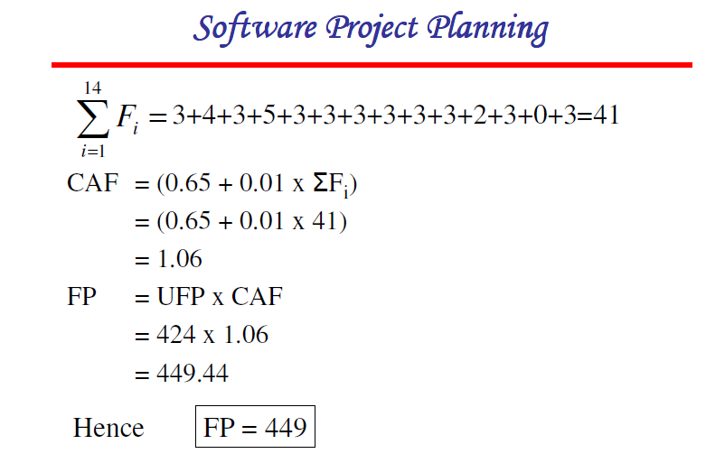

Slide 31
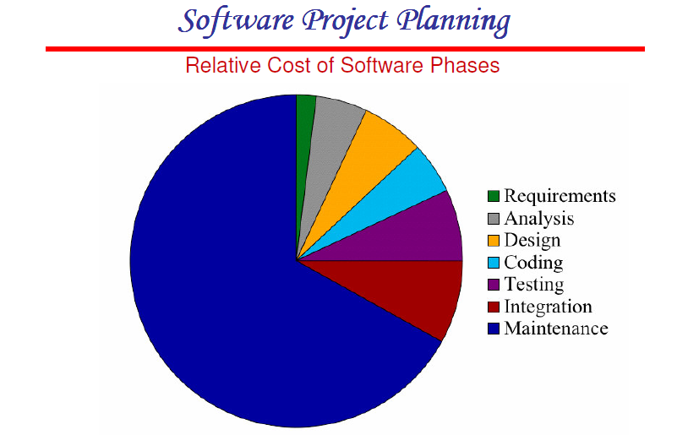

Slide 32
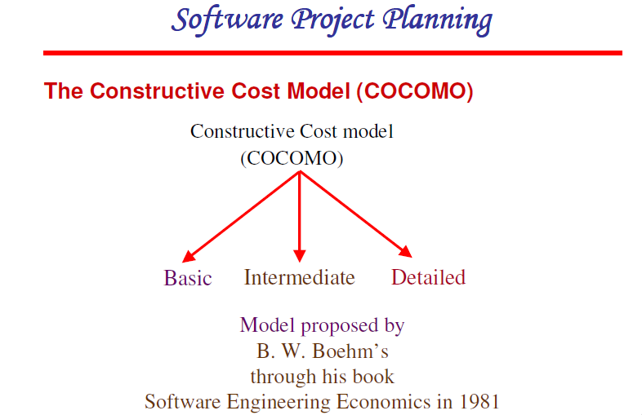

Slide 33
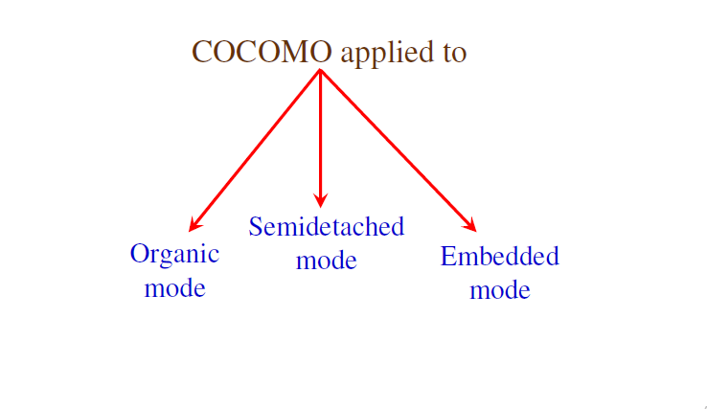

Slide 34
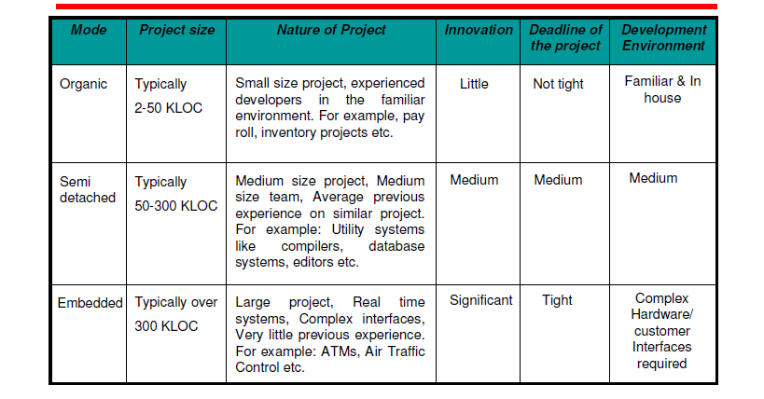

Slide 35
Types of Models:
COCOMO consists of a hierarchy of three increasingly detailed and accurate forms.
Any of the three forms can be adopted according to our requirements.
These are types of COCOMO model:
Basic COCOMO Model
Intermediate COCOMO Model
Detailed COCOMO Model

Slide 36
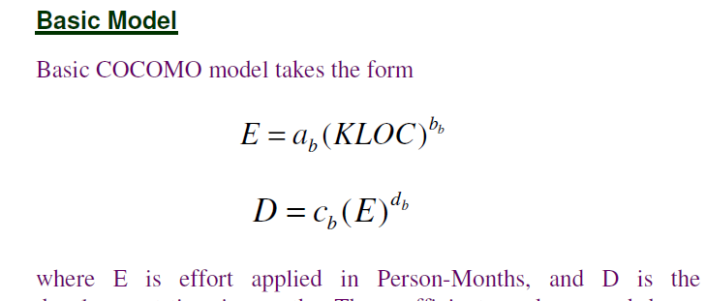



Slide 37
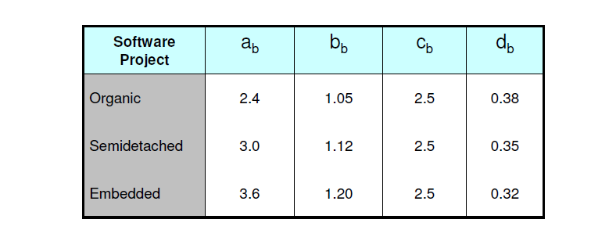


Slide 38
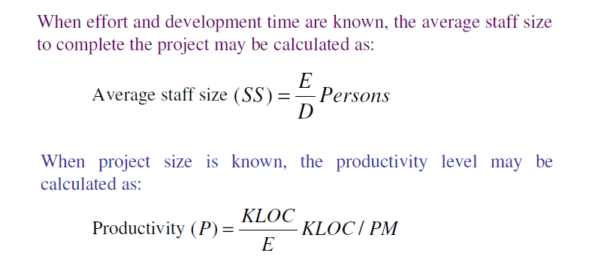

Slide 39
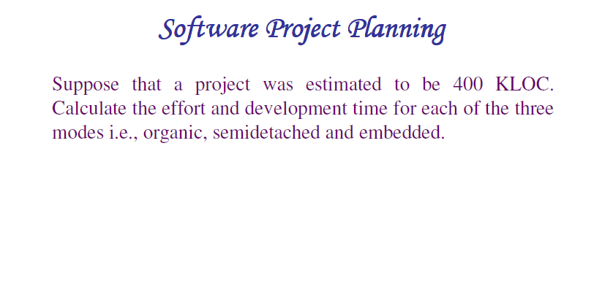

Slide 40
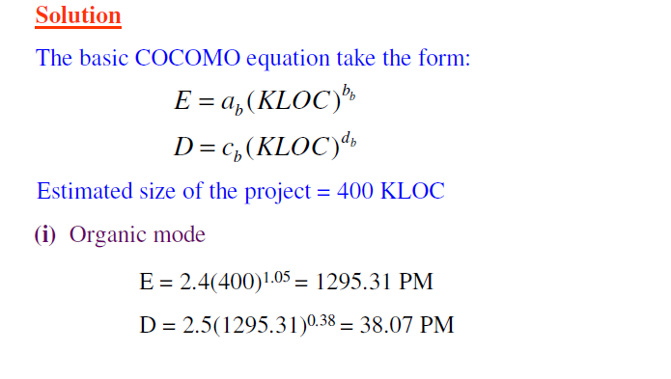

Slide 41
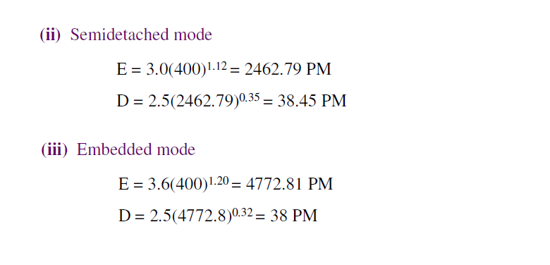

Slide 42
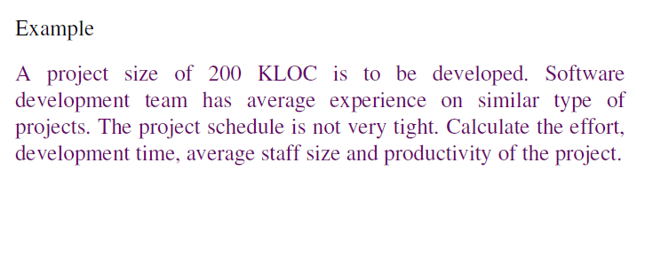

Slide 43
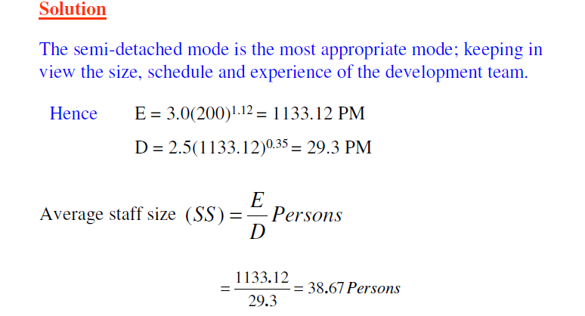

Slide 44
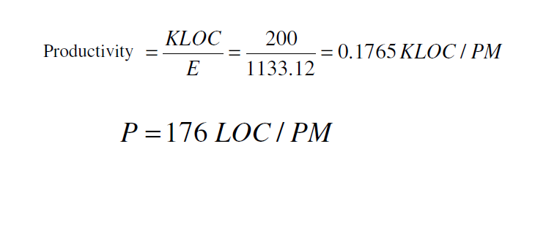

Slide 45
Intermediate Model
The basic COCOMO model considers that the effort is only a function of the number of lines of code and some constants calculated according to the various software systems. The intermediate COCOMO model recognizes these facts and refines the initial estimates obtained through the basic COCOMO model by using a set of 15 cost drivers based on various attributes of software engineering.

Slide 46
Classification of Cost Drivers and their attributes
(i) Product attributes -
Required software reliability extent
Size of the application database
The complexity of the product
Hardware attributes -
Run-time performance constraints
Memory constraints
The volatility of the virtual machine environment
Required turnabout time

Slide 47
Personnel attributes -
Analyst capability
Software engineering capability
Applications experience
Virtual machine experience
Programming language experience
Project attributes -
Use of software tools
Application of software engineering methods
Required development schedule

Slide 48
COST DRIVERS | VERY LOW | LOW | NOMINAL | HIGH | VERY HIGH
Product Attributes
Required Software Reliability | 0.75 | 0.88 | 1.00 | 1.15 | 1.40
Size of Application Database |  | 0.94 | 1.00 | 1.08 | 1.16
Complexity of The Product | 0.70 | 0.85 | 1.00 | 1.15 | 1.30

Slide 49
COST DRIVERS | VERY LOW | LOW | NOMINAL | HIGH | VERY HIGH
Hardware Attributes
Runtime Performance Constraints |  |  | 1.00 | 1.11 | 1.30
Memory Constraints |  |  | 1.00 | 1.06 | 1.21
Volatility of the virtual machine environment |  | 0.87 | 1.00 | 1.15 | 1.30
Required turnabout time |  | 0.94 | 1.00 | 1.07 | 1.15

Slide 50
COST DRIVERS | VERY LOW | LOW | NOMINAL | HIGH | VERY HIGH
Personnel attributes
Analyst capability | 1.46 | 1.19 | 1.00 | 0.86 | 0.71
Applications experience | 1.29 | 1.13 | 1.00 | 0.91 | 0.82
Software engineer capability | 1.42 | 1.17 | 1.00 | 0.86 | 0.70
Virtual machine experience | 1.21 | 1.10 | 1.00 | 0.90
Programming language experience | 1.14 | 1.07 | 1.00 | 0.95

Slide 51
COST DRIVERS | VERY LOW | LOW | NOMINAL | HIGH | VERY HIGH
Project Attributes
Application of software engineering methods | 1.24 | 1.10 | 1.00 | 0.91 | 0.82
Use of software tools | 1.24 | 1.10 | 1.00 | 0.91 | 0.83
Required development schedule | 1.23 | 1.08 | 1.00 | 1.04 | 1.10

Slide 52
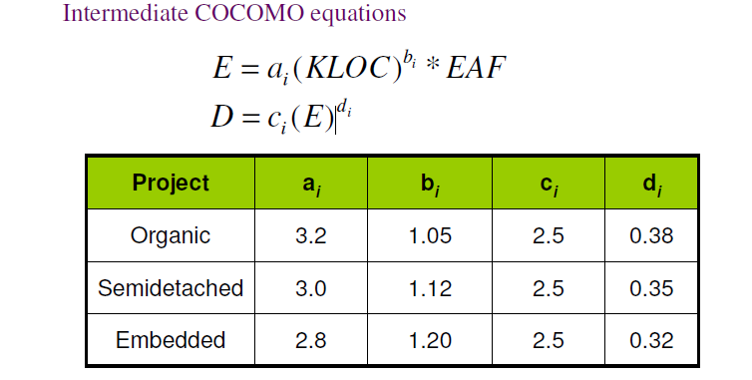

Slide 53
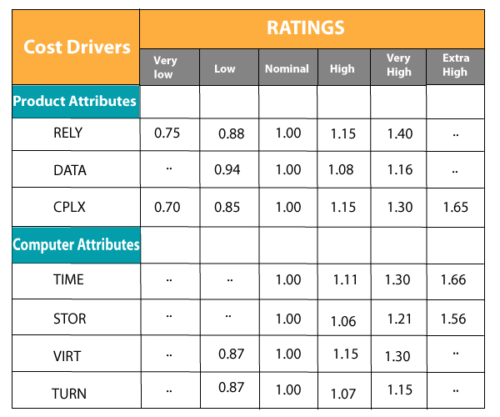

Slide 54
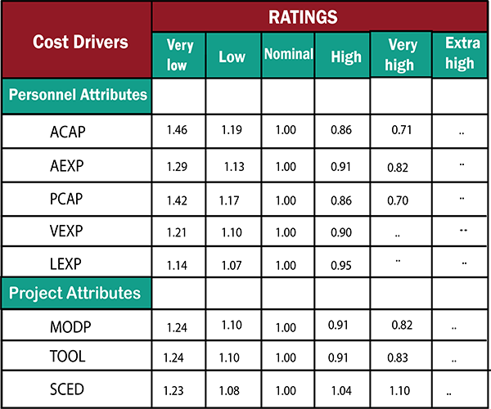

Slide 55
The project manager is to rate these 15 different parameters for a particular project on a scale of one to three. Then, depending on these ratings, appropriate cost driver values are taken from the above table.
These 15 values are then multiplied to calculate the EAF (Effort Adjustment Factor).

Slide 56
Detailed COCOMO Model
Detailed COCOMO incorporates all characteristics of the intermediate version with an assessment of the cost driver’s impact on each step of the software engineering process. The detailed model uses different effort multipliers for each cost driver attribute. In detailed cocomo, the whole software is divided into different modules and then we apply COCOMO in different modules to estimate effort and then sum the effort.

Slide 57
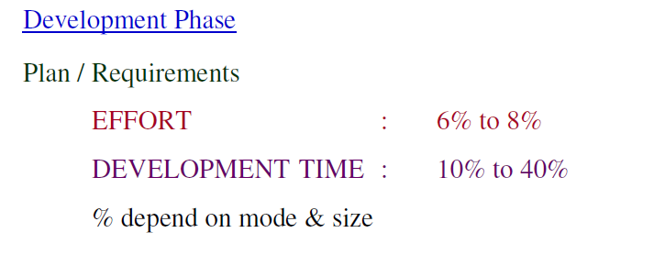

Slide 58
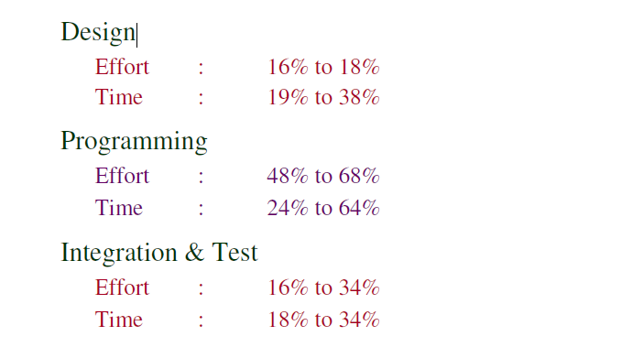

Slide 59
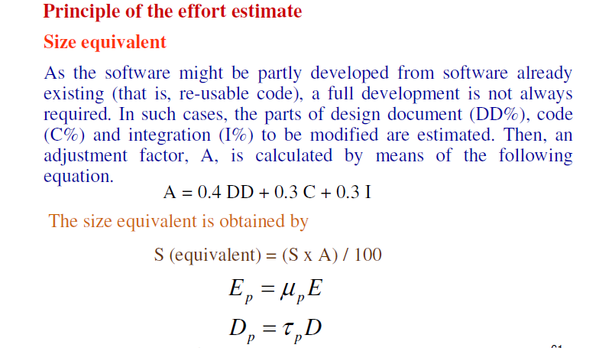

Slide 60
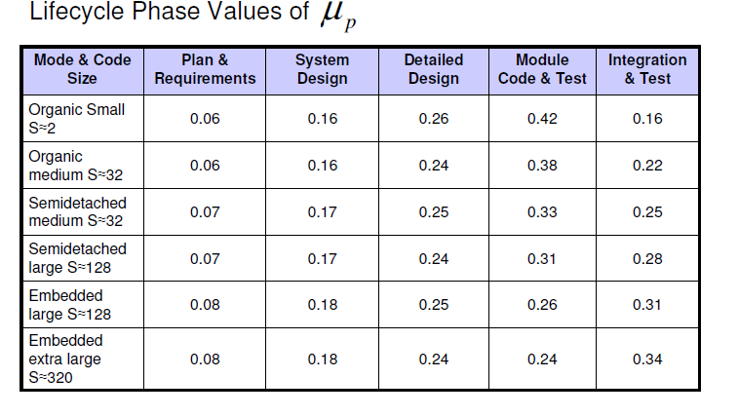

Slide 61
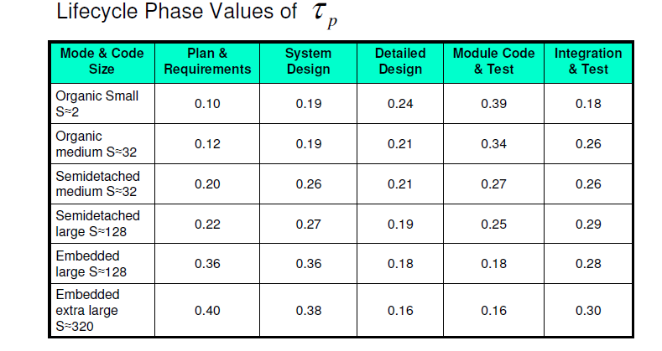

Slide 62
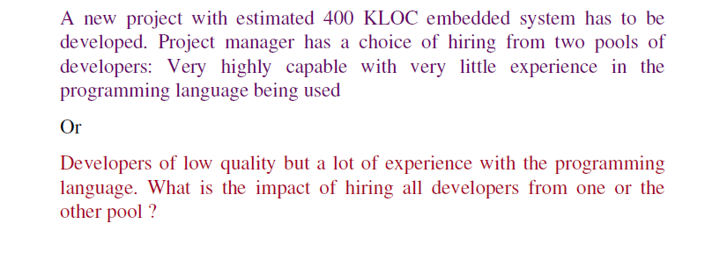

Slide 63
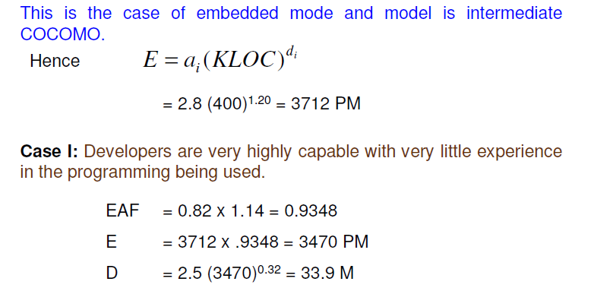

Slide 64
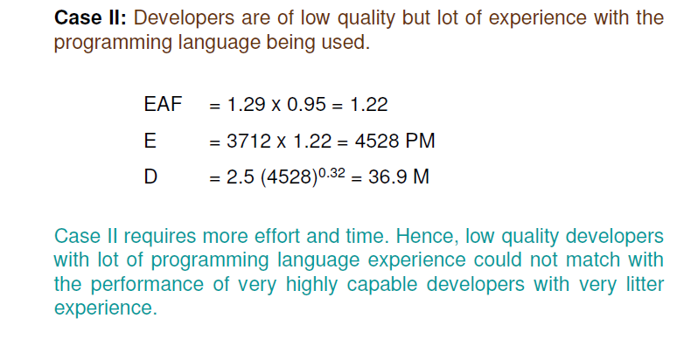

Slide 65
Problem
Consider a project to develop a full screen editor. The major components
identified are:
I. Screen edit
II. Command Language Interpreter
III. File Input & Output
IV.Cursor Movement
V. Screen Movement
The size of these are estimated to be 4k, 2k, 1k, 2k and 3k delivered source
code lines. Use COCOMO to determine
1. Overall cost and schedule estimates (assume values for different
cost drivers, with at least three of them being different from 1.0)
2. Cost & Schedule estimates for different phases.

Slide 66
Size of five modules are:
Screen edit = 4 KLOC
Command language interpreter = 2 KLOC
File input and output = 1 KLOC
Cursor movement = 2 KLOC
Screen movement = 3 KLOC
Total = 12 KLOC

Slide 67
i. Required software reliability is high, i.e.,1.15
ii. Product complexity is high, i.e.,1.15
iii. Analyst capability is high, i.e.,0.86
iv. Programming language experience is low,i.e.,1.07
v. All other drivers are nominal
EAF = 1.15x1.15x0.86x1.07 = 1.2169

Slide 68
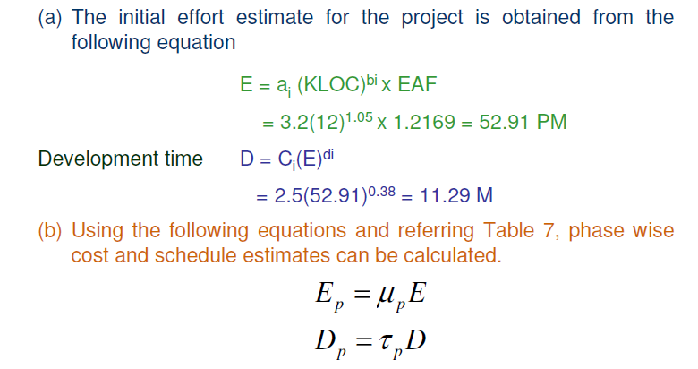

Slide 69
